Slide 1

College of Charleston’s Webmail vs. Gmail
By Chelsea DeZearn and S. Ryan Morris
April 23, 2008

Slide 2

Pros of Webmail:
Ease of Layout
Folder Manager
Message Received?
HELP!!
Spam Filter

Slide 3

Cons of Webmail:
Any Day Now…..
Lack of Storage
Address Books

Slide 4
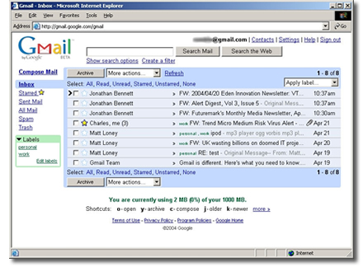
Pros of Gmail:
NO MORE SPAM!
Countless Features
Google Chat
User-Friendly Layout
Labels

Slide 5
Cons of Gmail:
Email from Professors
Emails to Professor’s Junk Mailbox

Slide 6
Conclusion:
Although the College of Charleston’s Webmail and Gmail have a lot of features in common, the overwhelming speed and storage capacity of Gmail is the number one reason why the College of Charleston should switch its server over to a Gmail system.
        Thank You.

